Slide 1
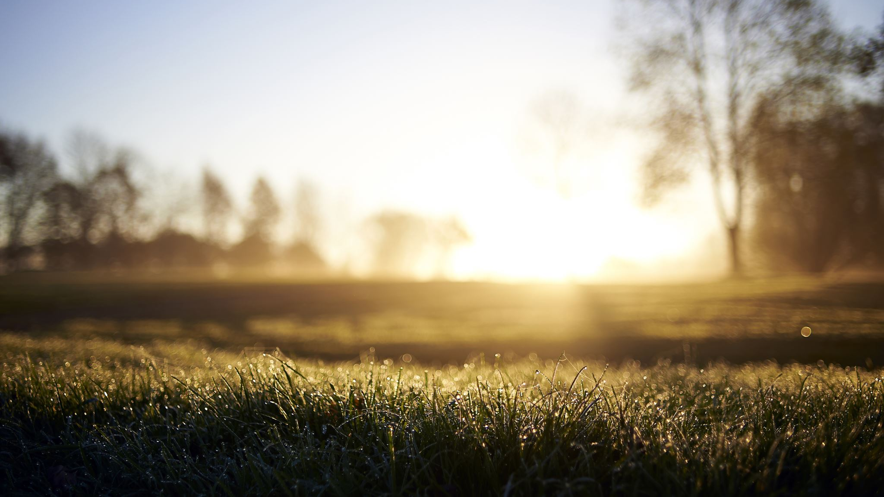
THE SONOMA COUNTY CIVIL GRAND JURY
What is it, and why should you apply?

Slide 2
WHAT IS THE SONOMA COUNTY CIVIL GRAND JURY?
The Sonoma County Civil Grand Jury is:
A citizen whatchdog function authorized by the California State Constitution
An investigative body; an “arm of the Court” – Assesses action and performance of local government entities
A group of 19 citizens serving a 12-month term. Every California County has a civil grand jury.

Slide 3
How does the Sonoma County Civil Grand Jury function and operate?
It is not like regular jury duty!
Members of the Civil Grand Jury decide the best way to get the work done.
Some best practices carry over year to year, such as committee/team structure and leadership roles, meeting and training schedules, and documentation standards.
In many years, holdover jurors (a juror who served the previous year) provide continuity for new members.
Legal support is provided by the Sonoma County Counsel’s Office.

Slide 4
Sonoma County Civil Grand Jury Structure
Sample Investigative Subjects
Administration and Fiscal / Audit of Cities and Special Districts
Education Department reviews
Health and Human Services reviews
Law Enforcement reviews
Public Works Departments’ reviews
Environment reviews
Safety and Transportation reviews

Slide 5
Grand Jury Schedule and Time Commitments
Meet 1 -2 hours weekly as a group (called the Plenary).
Committees Chairs and Foreperson meetings may occur, usually before Plenary.
Individual committee meetings (planning and discussion).
Committees and Investigation teams schedule interviews & working session and site visits in between the Plenary sessions based on their availability.
Commitment averages 10-25 hours per week, although this can increase as reports are written and reviewed.

Slide 6
What to Investigate?
Brainstorming session
Hot topics in the news
Written formal requests/complaints from the general public
Follow-ups to previous investigations
Ideas from other county civil grand juries
Leads from background research
Main Adult Detention Facility Inquiry
The Sonoma County Civil Grand Jury averages 5-8 investigations and/or reports per year.

Slide 7
Typical Investigation Process
Do background research – make the case
Present potential topic to full Grand Jury for comments, review and approval
Investigate – conduct interviews, perform document reviews, do surveys, visit sites
Document and confirm Findings, Conclusions, and Recommendations in a report
Submit to Fact Checking and Editorial Review – most go through multiple drafts and revisions
Present report to full 19-member Grand Jury for final approval

Slide 8
Final Grand Jury Report
Approved reports are reviewed by assigned County Counsel and Judge before issuance.
Reports are issued to responsible authorities (Board of Supervisors, Mayors/City Councils, Agency Heads).
Press releases notify the media of new reports.
Authorities have 90 days to formally respond to Findings and Recommendations.

Slide 9
Final Report Impact
Recipients are not legally required to implement recommendations but must respond in writing.
Findings are sometimes “challenged.”
The rigorous process can result in many recommendations being implemented over time.
Twenty years of reports and responses are available on
The Sonoma County Civil Grand Jury website

Slide 10
Recent Sonoma County Grand Jury Topics
Affordable Housing: Monitoring and Compliance
Affordable Housing: Past, Present and Future
Department of Health Services
Rohnert Park Department of Public Safety
SMART Decision Making
What Happens When the Grand Jury Makes Recommendations

Slide 11
Juror Selection Qualifications
Must be a U.S. Citizen and at least 18 years old.
Must have lived in Sonoma County for at least one year.
Must be sufficiently fluent in English sufficient to perform duties.
Must not presently serve as an elected official.
Must never have been convicted of a malfeasance in office or any Felony or other higher crime.
Not currently serving as a trial juror.
Not discharged as a grand juror within one year prior to commencement of term of office.
In possession of natural faculties, of ordinary intelligence, of sound judgement and of fair character.

Slide 12
Ideal Grand Juror Attributes
Available / flexible – 5 to 15 hours a week (more time commitment during report writing).
Interested in local government and community issues. Enjoys learning new things, teamwork.
Has basic to advanced computer skills (utilization of email, ability to communicate using Word documents, conducting web-based search functions, Video Conferencing and preparing basic Spreadsheets.
Has good writing skills – e.g., for interview notes, report drafts.
Meets commitments and is comfortable expressing/defending positions but open to change based on the data.
Able to maintain strict confidentiality at all times.

Slide 13
HOW TO LEARN MORE/APPLY
Check the Sonoma County Civil Grand Jury website for more information at: https://sonoma.courts.ca.gov/general-information/grand-jury
Read past reports and utilize the on-line Grand Jury Application form from this website: https://sonoma.courts.ca.gov/general-information/grand-jury
Send an inquiry to: Grand.Jury@sonomacourt.org

